Slide 1
Exploring Conversations as a Platform
[ speaker name]
[ speaker contact methods ]
Notes:
Put your details above.
Each slide contains example script in the notes. Once confident with the content, you can use the headings in the notes as cues to ad-lib the content in your own words.

Slide 2
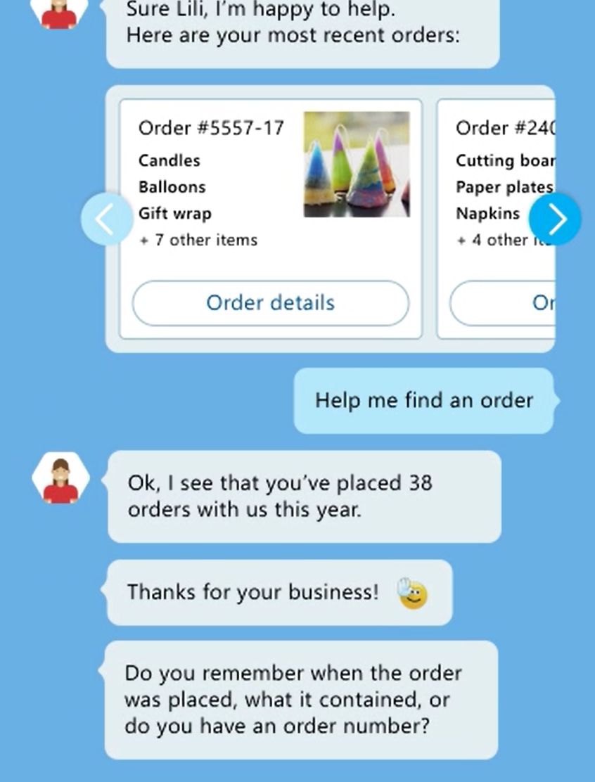
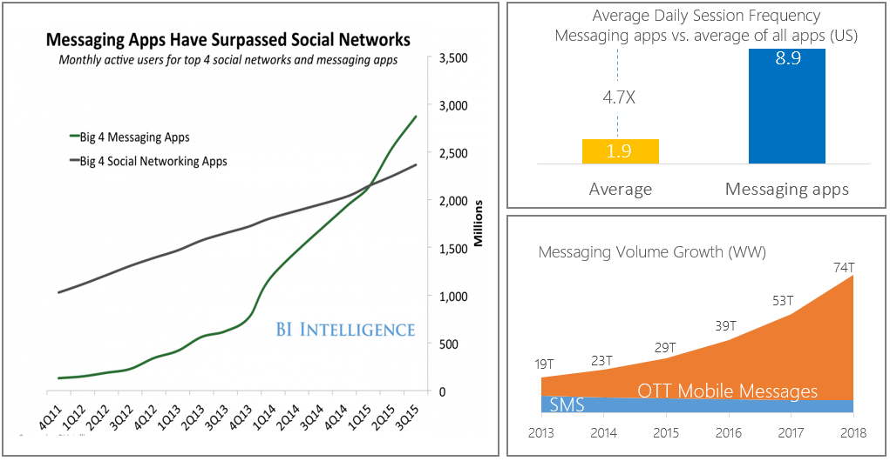
Messaging is King
Monthly active users of the top 4 messaging apps surpassed monthly active social network app users in Q1 2015
Source: BI Intelligence, Portico Research

Slide 3
Bot or not?
Bots:
Don’t just search with query results
Act as agent for user
Translate user intent
Perform actions
Combine data from multiple sources
Maintain dialog context
May exhibit personality

Slide 4
Demo
Fun with a Skype bot
Notes:
Demo 1.1

Slide 5
Messaging Forecasts
By 2018, at least 50% of the newest versions of enterprise software products will include some CaaP-based capabilities
65% of smartphone owners already use voice assistants on their phone
By 2020, at least 80% of new enterprise application releases will make reasonably strong use of chatbots
80% of executives believe artificial intelligence improves worker performance and creates jobs
Source: BI Intelligence, Portico Research

Slide 6
Potential Benefits
Engage with the chat-generation
Lowered business cost to serve internally and externally
Improved resource focus on other tasks
More quickly connect users with information and services
Act as a friendly navigator for legacy or cumbersome data

Slide 7
Industry Momentum
8
800M
monthly active WeChat users, 200M with credit cards linked to their accounts
67,000
developers on Microsoft’s Bot Framework
55,000
15,000
bot developers on Facebook*
skills in the Amazon Alexa store

Slide 8
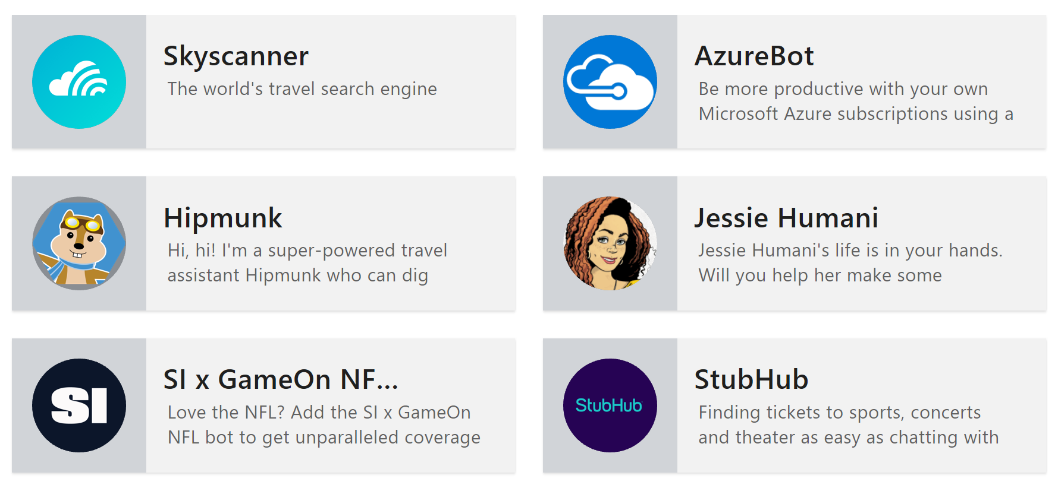

Real bots

Slide 9
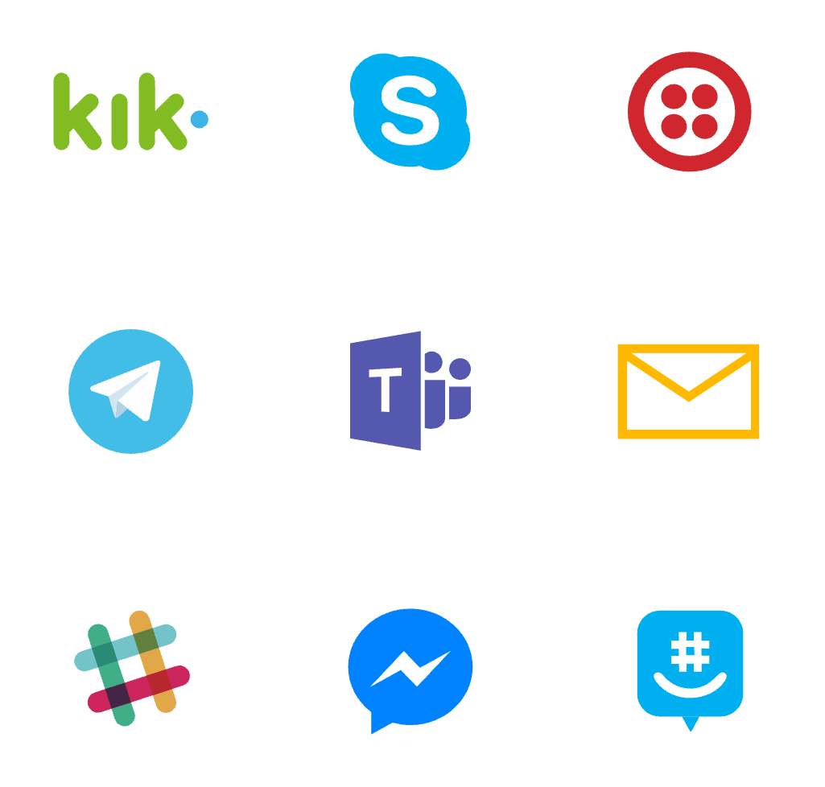
Where bots live

Slide 10
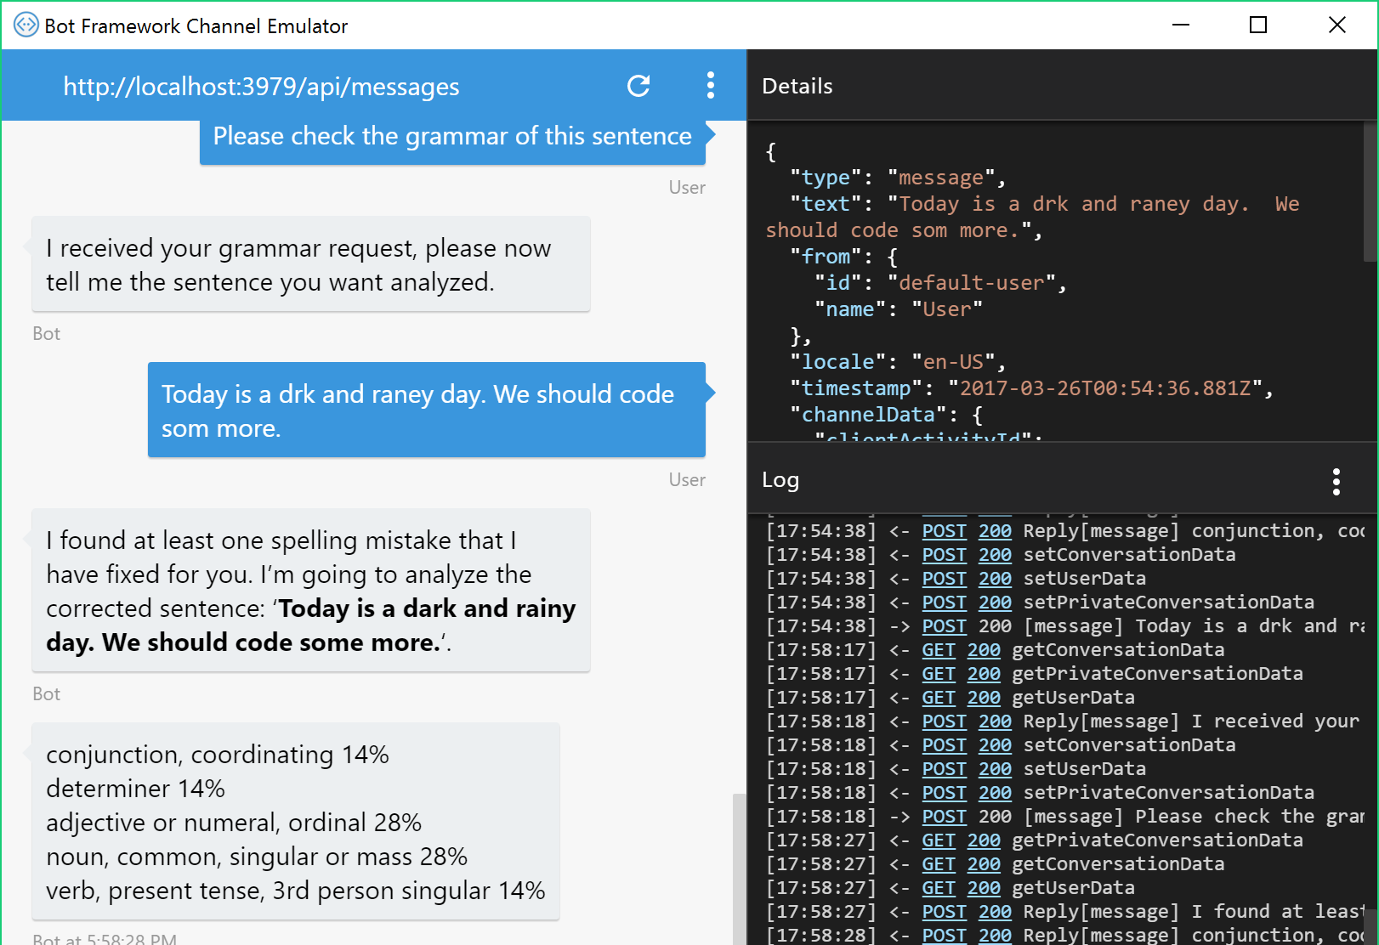
The Tools
Bot Framework SDK for .NET
Bot Framework SDK for node.js
Emulator
Registration portal
Azure (or any website) for hosting

Slide 11
Demo
A greeting bot in C# & node.js
Notes:
Demo 1.2

Slide 12
The Cognitive Services
Vision | Speech | Language | Knowledge | Search
Computer Vision Content Moderator Emotion Face Video | Bing Speech Custom Speech Service Speaker Recognition | Bing Spell Check Language Understanding Linguistic Analysis Text Analytics Translator WebLM | Academic Entity Linking Knowledge Exploration QnA Maker Recommendations | Bing Autosuggest Bing Image Search Bing News Search Bing Video Search Bing Web Search

Slide 13
LUIS
“Language Understanding Intelligence Service”
For an app, deals with a number of “Intents” & “Entities”.
Trained with a number of “Utterances” for each intent with Entity placement.
Determines with a degree of confidence which intent was meant from a given phrase.
Provides the Intent and extracted Entities to application.
Developer can see stats on Intents selected by LUIS over time and can guide the training based on actual user utterances.

Slide 14
Demo
Bot + 4 Cognitive Services
Notes:
Demo 1.3

Slide 15
Summary
Messaging has become a dominate form of communication.
There a significant cost saving, efficiency and user connection benefits to using bots.
The Bot Framework enables bots to be built in several languages, be hosted in many places and appear in many channels.
Cognitive Services bring significant power to the framework.

Slide 16
Resources
Further sessions in this series:
Starting with Conversations as a Platform – The building blocks and services behind the Grammar app
Docs & getting started - https://dev.botframework.com/
Webchat control - https://github.com/Microsoft/BotFramework-WebChat
Learn and try Cognitive Services at - https://www.microsoft.com/cognitive-services
Notes:
As shown

